Slide 1
Trigonometry
Dr Anjali Pant
HOD,
Department of Applied Science
Govt. Polytechnics , Shaktifarm, Uttarakhand, India

Slide 2
Trigonometry
Trigonometry is derived from the Greek words trigonon (three - angle) and metron (measure). Thus trigonometry means the measurement of triangles.
Trigonometry deals with right angle triangle.

Slide 3
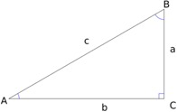
In triangle ABC the angle C be of 90º. Side AB will be hypotenuse , AC is base and BC is perpendicular.
Adjacent: It will be the side adjacent to the angle being considered.
Opposite: It will be the side opposite to angle being considered.
Hypotenuse: It will be the side opposite to the right angle of the triangle (or the largest side).
sinθ = Perpendicular/ Hypotenuse= Opposite/Hypotenuse
cosine or cosθ = Base/ Hypotenuse= Adjacent/Hypotenuse
tangent or tanθ = Perpendicular/Base= Opposite/Adjacent.

Slide 4
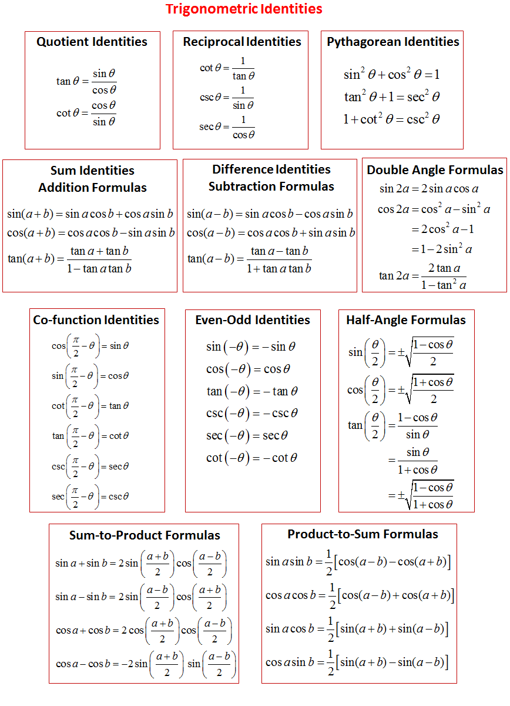

Slide 5




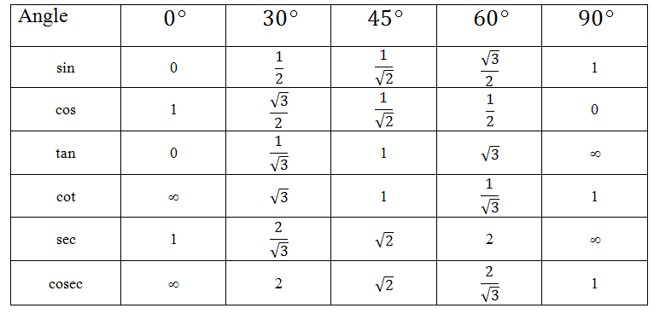
Values of Trigonometric Function

Slide 6
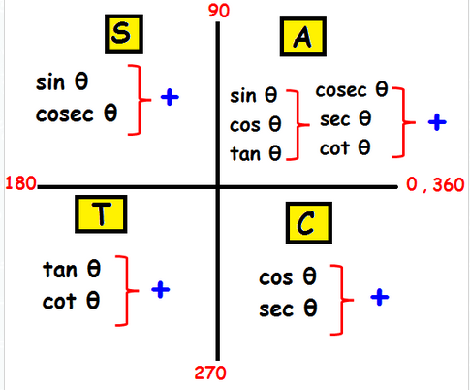
ASTC Formula

Slide 7
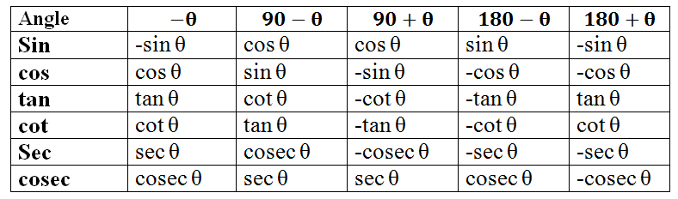
Reference angle Values in Various Quadrants

Slide 8
Applications of Trigonometry
IN HEIGHTS AND DISTANCE
Trigonometry is used to in measuring the height of a building or a mountain. The distance of a building from the viewpoint and the elevation angle can easily determine the height of a building using the trigonometric functions.

Slide 9
Applications of Trigonometry cont..
IN THE ARCHITECTURE OF BUILDINGS
Architects have to calculate exact angles of intersection for components of their structure to ensure stability and safety. Architecture include arches, domes, support beams, and suspension bridges.

Slide 10
Applications of Trigonometry cont..
IN GEOLOGY
Structural geologists use trigonometry to determine the real dip from an apparent dip to correct distortions in satellite imaging for maps.
Seismologists use trigonometry to accurately determine the epicenter of an earthquake.
Paleontologists use trigonometry to determine the actual width of a geological bed in Earth's crust.

Slide 11
Applications of Trigonometry cont..
IN THE NAVIGATION PROCESS
Used in navigating directions; it estimates in what direction to place the compass to get a straight direction.

Slide 12
Applications of Trigonometry cont..
IN OCEANOGRAPHY
Used in oceanography to calculate heights of waves and tides in oceans.

Slide 13
Applications of Trigonometry cont..
TRIGONOMETRY IN CRIMINOLOGY
Trigonometry is even used in the investigation of a crime scene. The functions of trigonometry are helpful to calculate a trajectory of a projectile and to estimate the causes of a collision in a car accident. Further, it is used to identify how an object falls or in what angle the gun is shot.

Slide 14
Applications of Trigonometry cont..
TRIGONOMETRY IN DEVELOPING COMPUTER MUSIC
Sound travels in the form of waves and this wave pattern through a sine or cosine function for developing computer music

Slide 15
Applications of Trigonometry cont.
TRIGONOMETRY IN AVIATION
The speed, direction and distance as well as the speed and direction of the wind is considered in aviation. The wind plays a vital role in when and how a flight will travel.

Slide 16
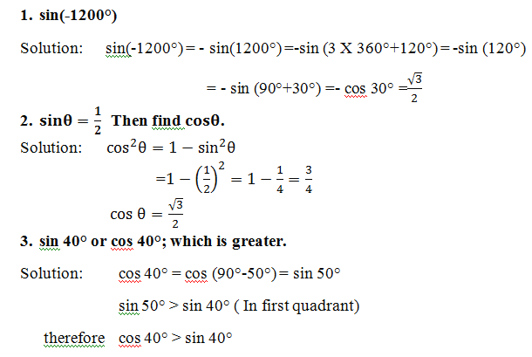
Questions and their Solutions-1 (Trigonometric Identities)

Slide 17
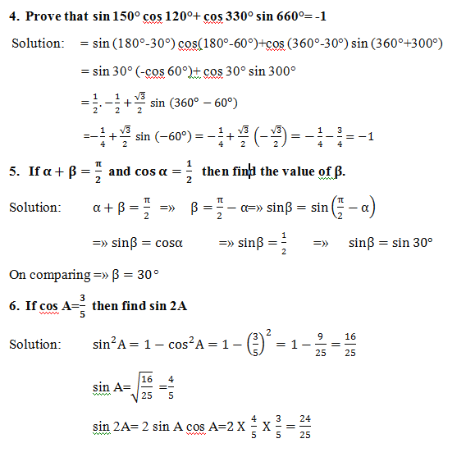

Slide 18
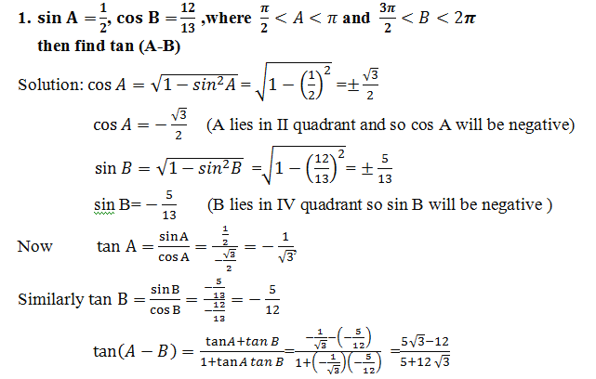
Questions and their Solutions-2 (Sum and difference Identities)

Slide 19
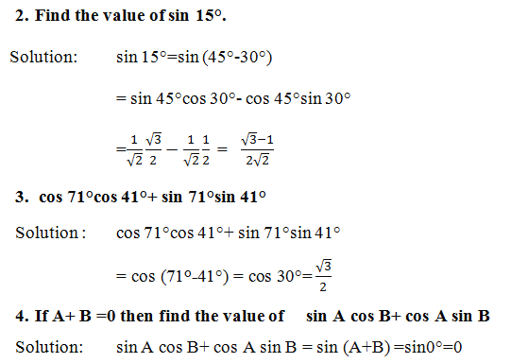

Slide 20
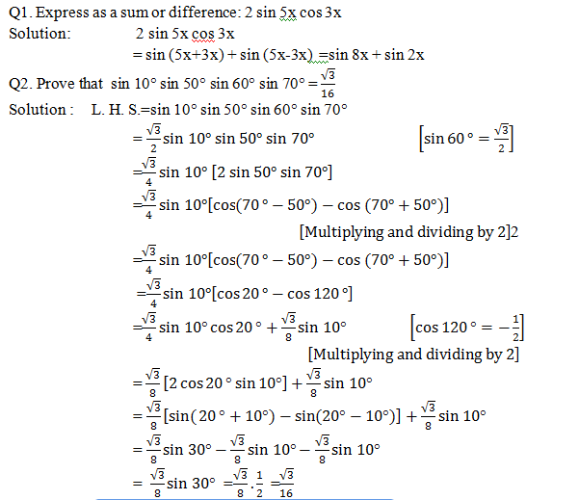
Questions and their Solutions - 3 (Transformation of a product into a sum or a difference)

Slide 21
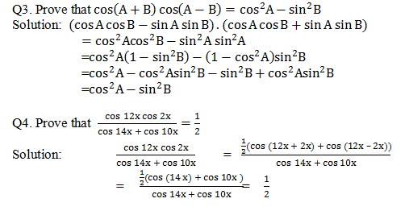

Slide 22
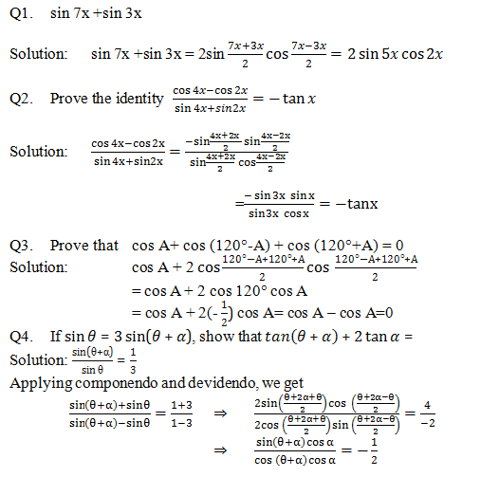
Questions and their Solutions - 4 (Transformation of a Sum or a Difference into product)

Slide 23
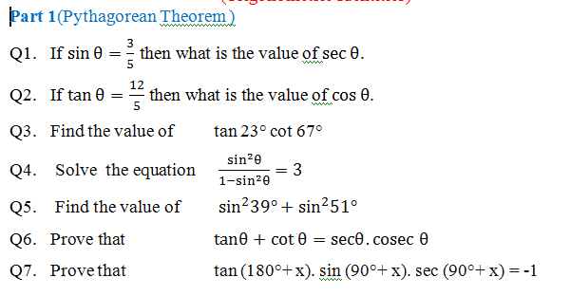
Assignment-1 (Trigonometric Identities)

Slide 24
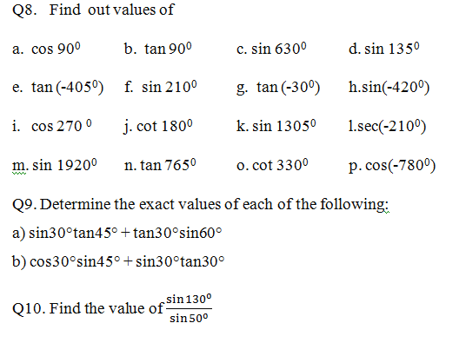

Slide 25
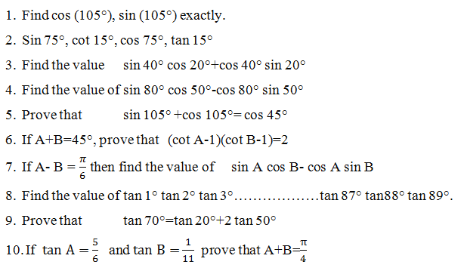
Assignment- 2 (Sum and difference Identities)

Slide 26
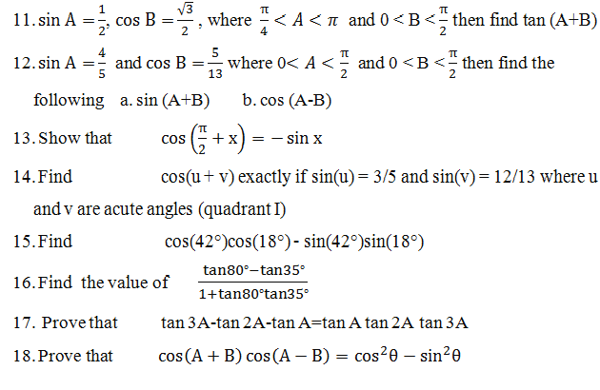

Slide 27
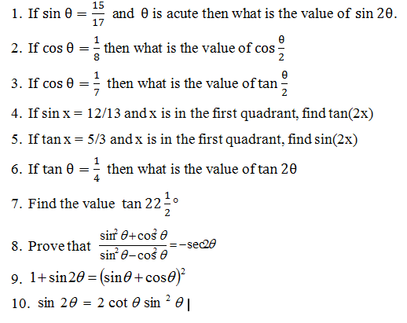
Assignment - 3 (Double and half angle formula)

Slide 28
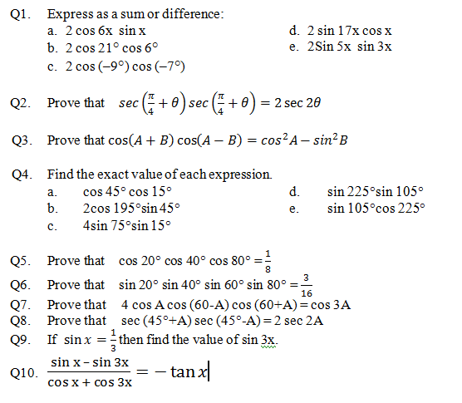
Assignment - 4 (Transformation of a product into a Sum or a Difference)

Slide 29
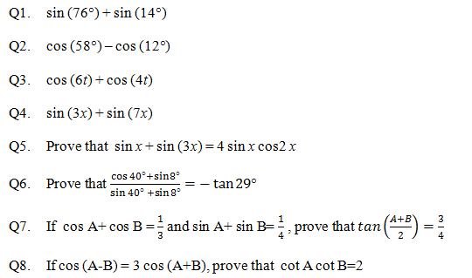
Assignment - 5 (Transformation of a Sum or a Difference into product)

Slide 30
REFERENCES
Loney, S. L. (1896), Plane Trigonometry. Cambridge University Press .
Kanyal, M. K. (2019).Applied Mathematics. Khanna Publishers, New Delhi.
Sharma, R.D. Applied Mathematics, Dhanpatrai Publications, New Delhi.
Sabharwal, S. S, Jain Sunita Rani, and Sharma Satish,.(2016). Simplified Approach to Applied Mathematics -1. Edition- New Syllabus, Eagle Prakashan, Jalandher.

Slide 31
Thank You

